Slide 1
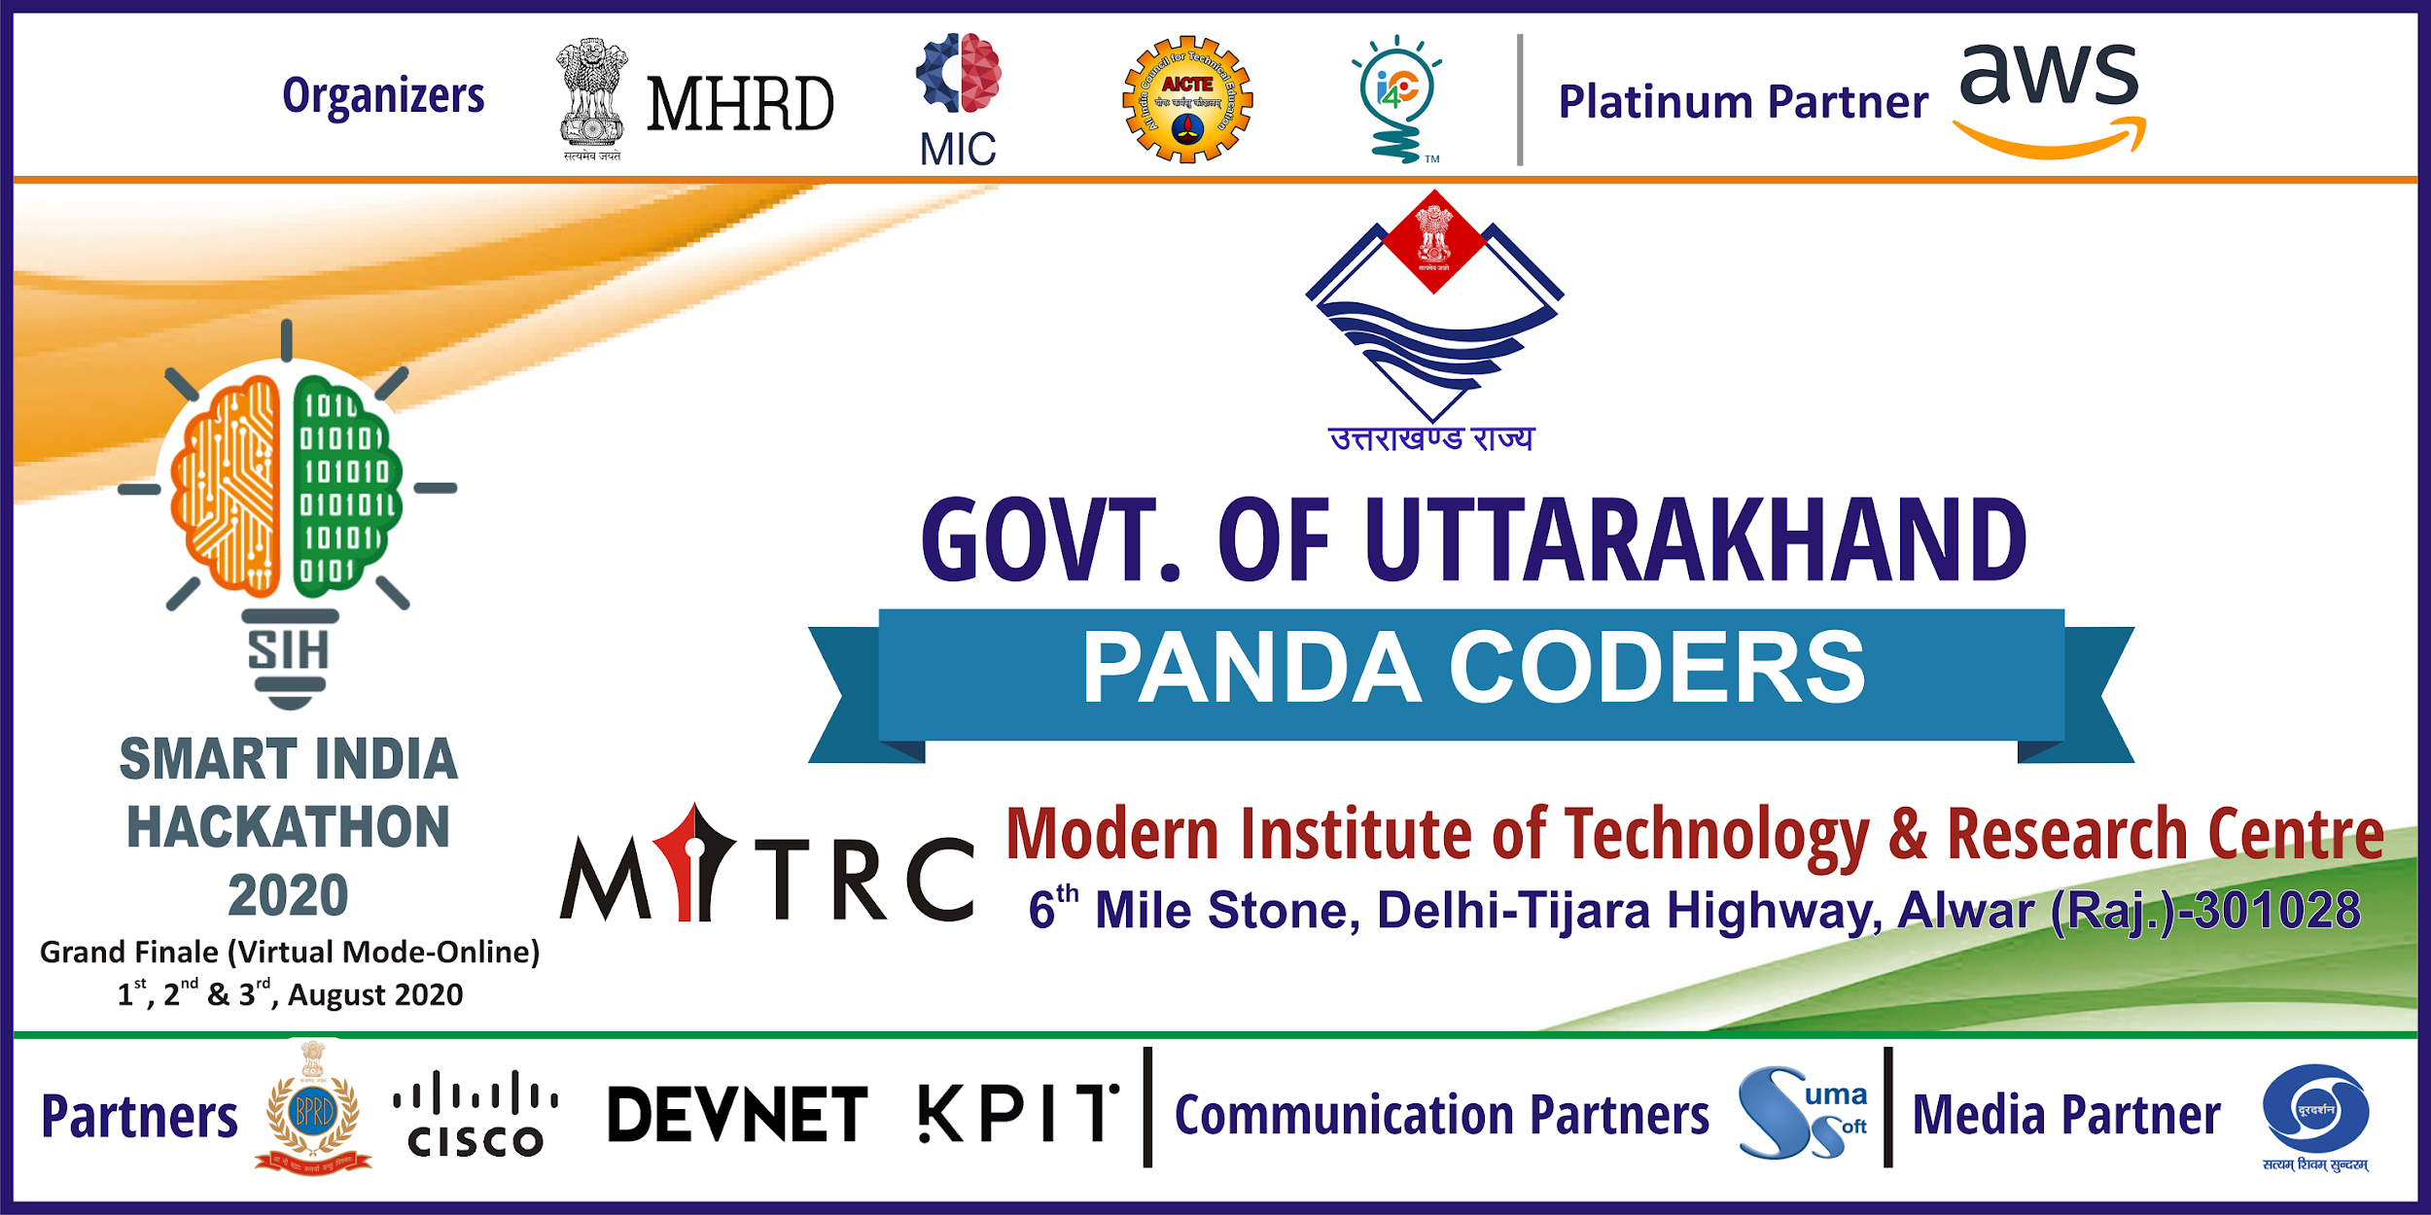

Slide 2


SMART INDIA HACKATHON
MINISTRY/ORGANIZATION NAME : Govt. Of Uttarakhand
PROBLEM STATEMENT : Developing a Scientific Career Counselling Software
PROBLEM CODE : MK106
TEAM LEADER : Gargi Gupta
PROBLEM CATEGORY : Software
THEME : Smart Education
TEAM NAME : Panda Coders
COLLEGE CODE : 1-3512866904

Slide 3
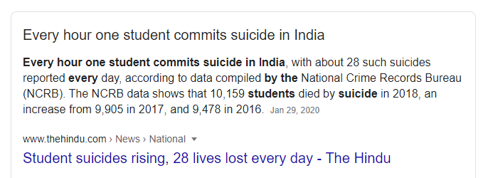
PROBLEM STATEMENT
Developing a Career Counselling Software for School Students , Graduates and Dropouts to provide them career guidance
PROBLEM
Students are often mislead in opting for best career, which needs to unemployment,depression and increased suicides.

Slide 4










PROTOTYPE MODEL
Natural Language Processing
COUNSELLOR
CHATBOT
Approve Questionnaire
PSYCHOMETRIC ANALYST
Answer your career related queries
Give Psychometric Test and receive guidance report
Multiple People Detector
APP
USER
CANDIDATE VERIFICATION SYSTEM
CNN MODEL
WEB SERVER
Fetching Data
DL Model to recognize emotion of the candidate during psychometric test
Query and Response
Add/Update New Set of Questionnaire
Face Recognition Module
Model to detect multiple user during test
MESSAGE BROKER
DATABASE
ADMIN
Docker container as AI Model server

Slide 5
SOLUTION APPROACH
We are developing an Android Application for users (School Students, Graduates and Dropouts) where the users will give a Psychometric test according to their level( skills, interest & aptitude) & receive career counselling from Recommendation Engine.
COUNSELLING BOT: It acts like a Counsellor. User can ask any career related queries to the bot.
A “Emotion Recognition System” will be built using CNN (Deep Learning) to detect user emotion during test which helps in analysing and providing relevant suggestions to user.
There will be an option of “Candidate Verification System” to detect multiple people during test and calculate confidence of user through LBPH Algorithm.
Psychometric Analyst will approve the question uploaded by admin.

Slide 6

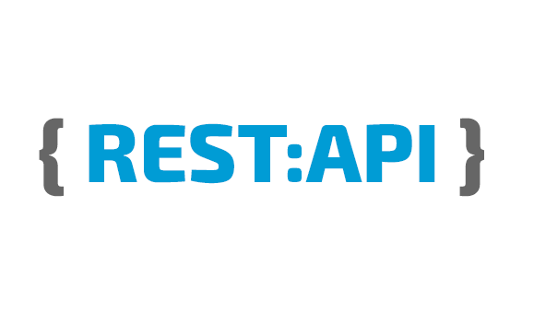

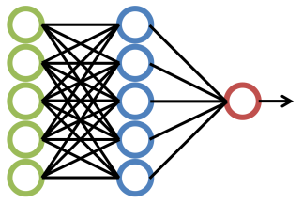




TECHNOLOGY STACK
LANGUAGES USED
Python 3.7
Dart
TECHNOLOGIES USED
Deep Learning
Docker(Handling ML Models and Huge data)
Rest API
Flutter
IDE USED
Google Colab
VS Code
DEPENDENCIES / SHOW TOPPERS
Response time will be dependent on internal DB operations and synchronous communication principle of Deep learning frameworks. Model may not give 100% accuracy.
Availability of training data set for deep learning modeling is abundant.
We require huge set of Psychometric questions for career counselling.

Slide 7
EMBEDDING EVALUTION SUGGESTIONS
Use Pre-build ML models for Multiple Face Detection and Emotion Recognition.
API is ready. Integration in progress
2. How will Kids(5-10 year old) will receive guidance?
IQ Test
Games/Puzzles
3. To include Guidance in other professions like Banking, Finance,etc?
Psychometric Tests specific to the field
Career Articles for guidance

Slide 8

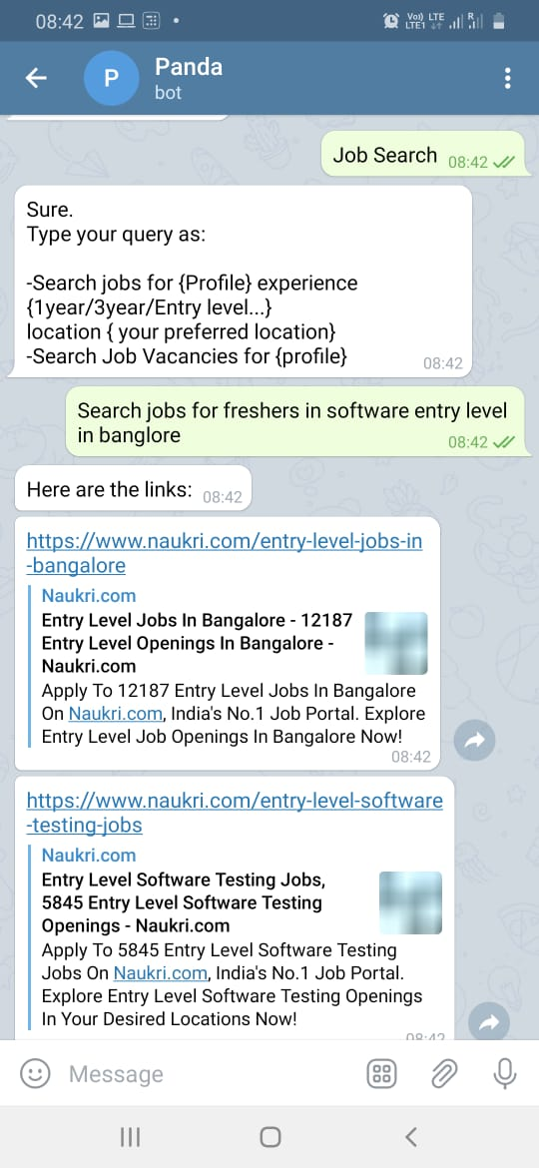
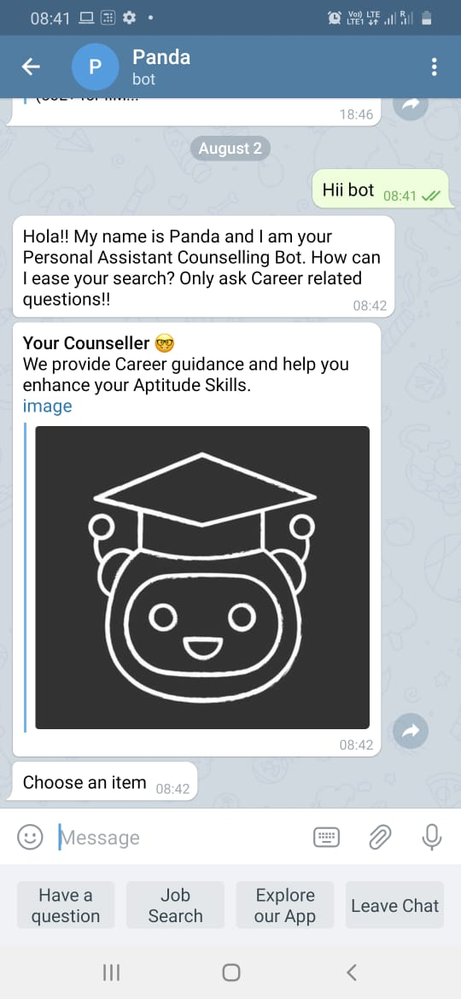
EMBEDDING 1ST EVALUTION SUGGESTIONS
4. How can a Graduate/Professional make the most use of the Application?
Job Search using Counsellor Bot
PROPOSED IDEA:
Ask the user if they are happy from current profession to wish to change!!
Accordingly take psychometric test to guide them based on their performance.

Slide 9
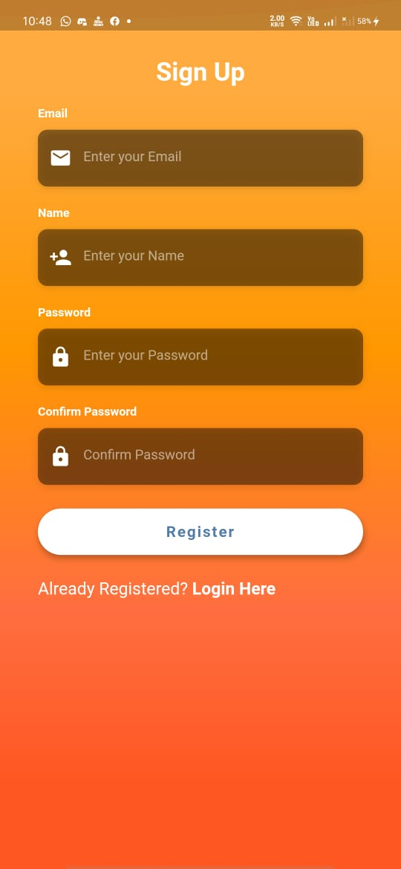
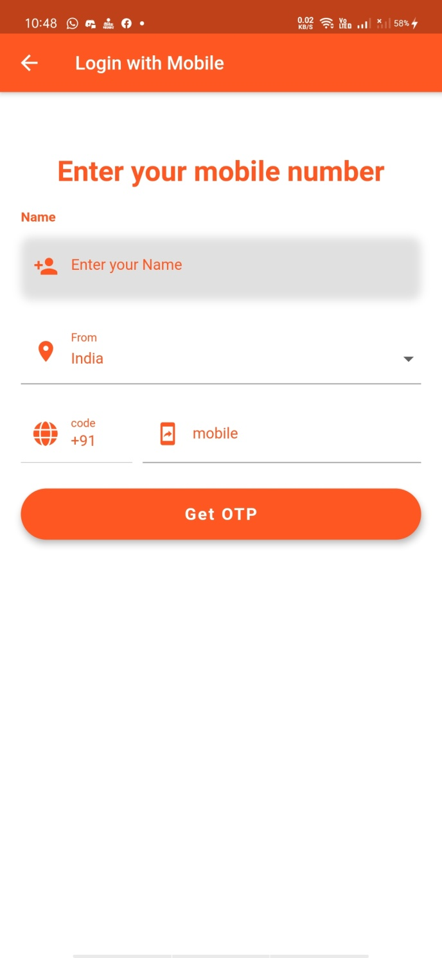
LOGIN/REGISTER

Slide 10
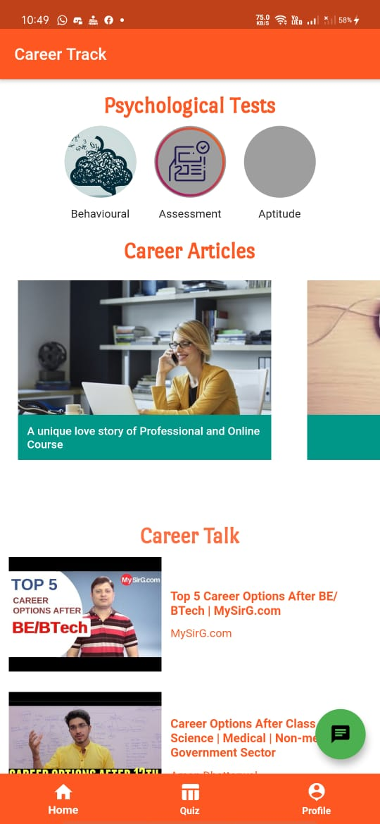
DASHBOARD
Dataset of Psychometric Questions is in progress:
Link: https://github.com/GargiGuptagd/NC_GEU_MK106_PANDACODERS

Slide 11
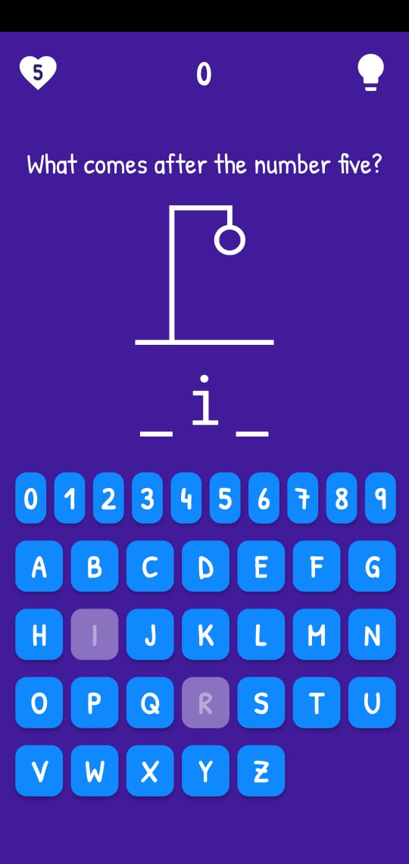
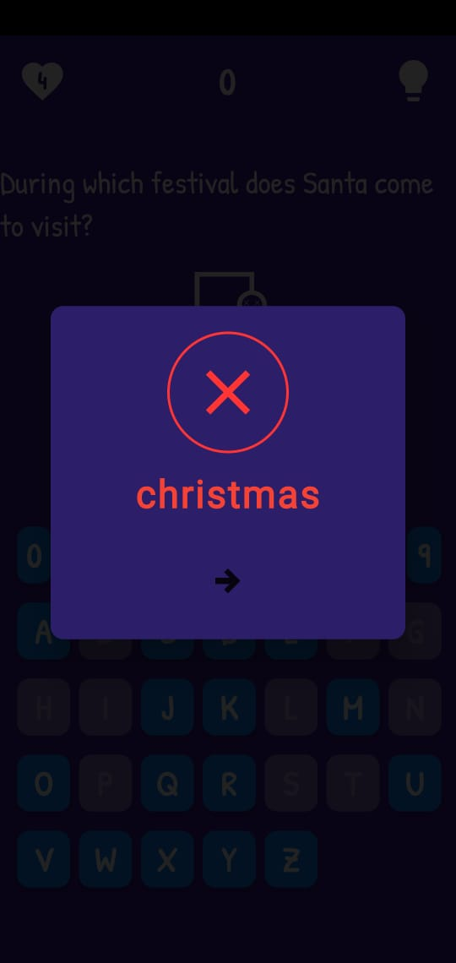
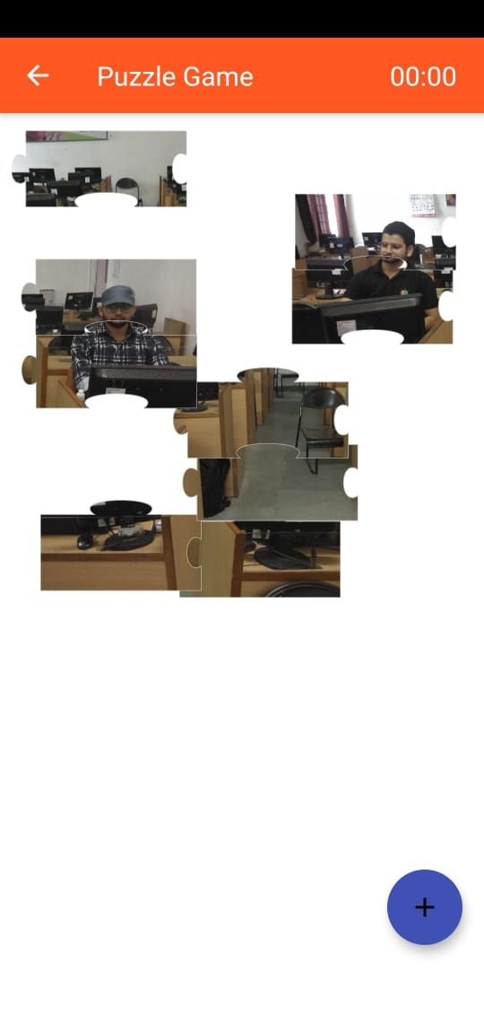
GAMES FOR KIDS

Slide 12
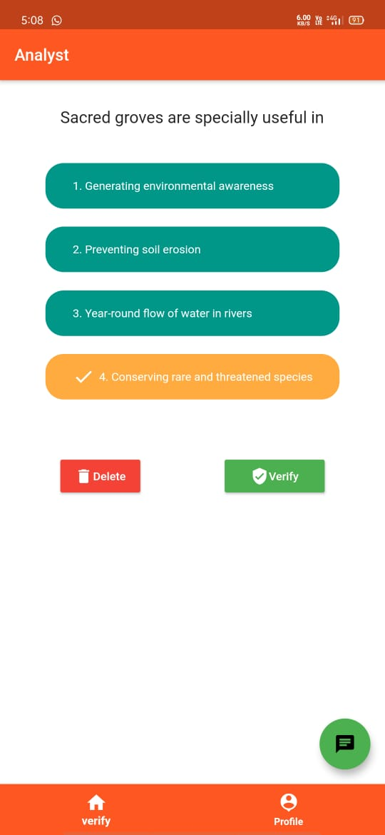
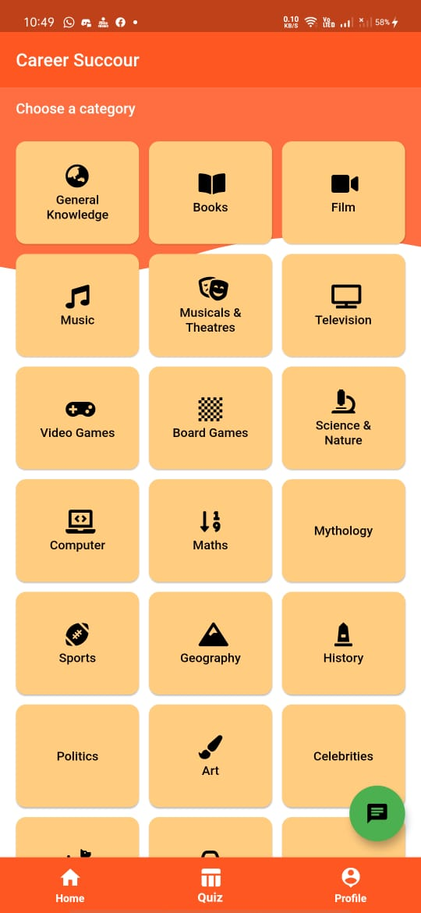
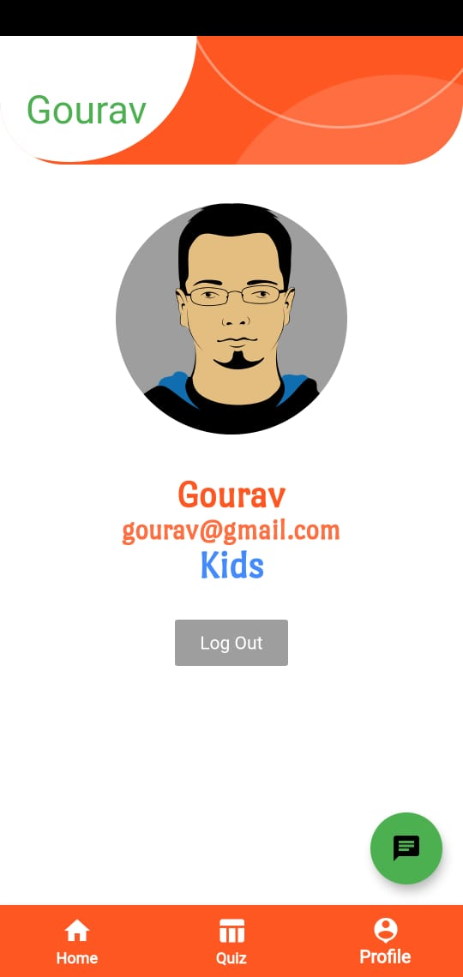
Analyst Screen
Categories
Profile

Slide 13
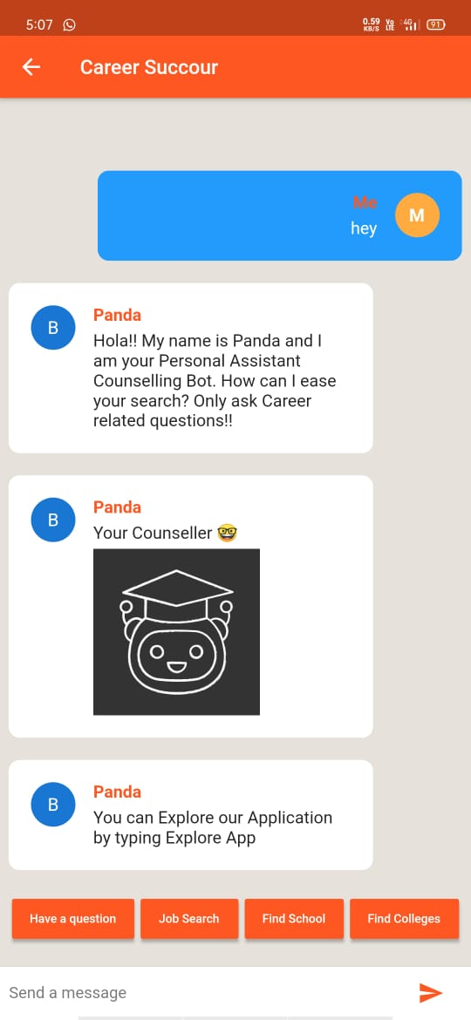
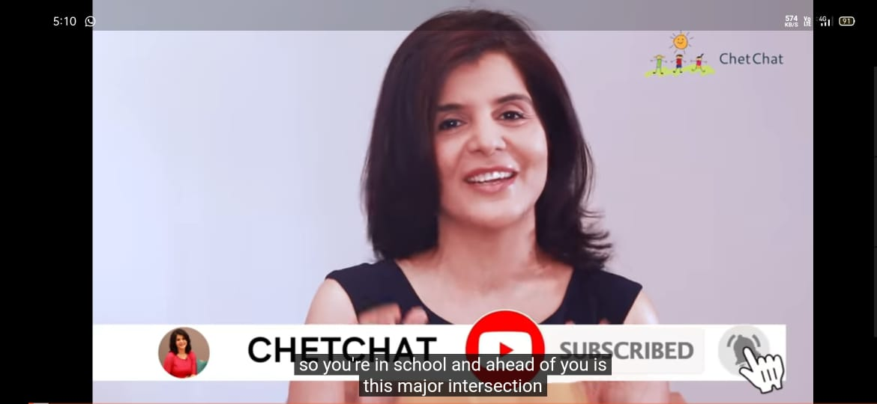
Career Talk Video
Panda Bot

Slide 14
FUTURE SCOPE
1. Increase the fields in Dropouts Section to enhance the counselling feature.
2. Increase the dataset of questionaire.
3. Include the psychometric analyst subject vise to verify the questions.
4. To show the recommendations and suggestions in a pdf format to download.
5. Enhance the chatbot to include voice recognition.

